Slide 1
STREAMLINING LIFE SAFING CONNECTIONS THROUGH BLOOD DONATION
- BY ARUNDATHI B

Slide 2
TABLE OF CONTENTS
01
02
COLLABORATORS AND THEIR ROLES
PROJECT DEMO

Slide 3
01
COLLABORATORS AND THEIR ROLES

Slide 4
OUR TEAM
SIRPIKHA V C
RASHMI C R
ARUNDATHI B
DEVELOPER
DEVELOPER
PRESENTER

Slide 5
OUR TEAM
SHERLEY LAZAR
MEGHANA A
YAMINI T
DOCUMENTOR
MANAGER
DOCUMENTATION

Slide 6
02
PROJECT DEMO

Slide 7
BLOOD DONAR MANAGEMENT SYSTEM
A website that provides an effective, efficient, and community-driven interface that enables the connection of donors with recipients in real-time. Its features include donor search, profile management, and education packages that make the whole general process of blood donations more effective, thus contributing to better health outcomes and stronger community engagement.

Slide 8
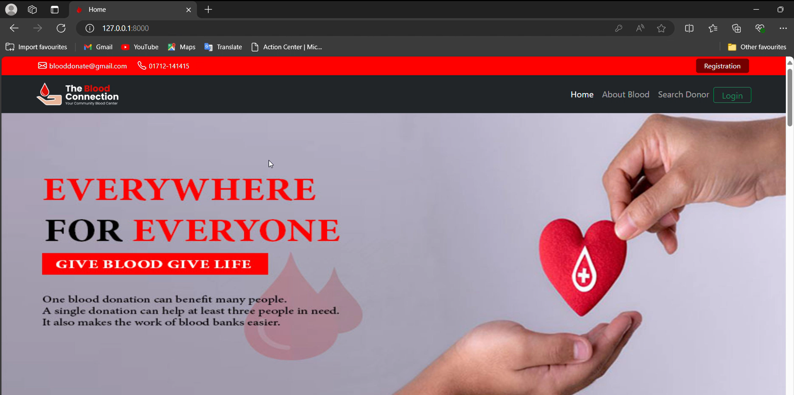

Slide 9
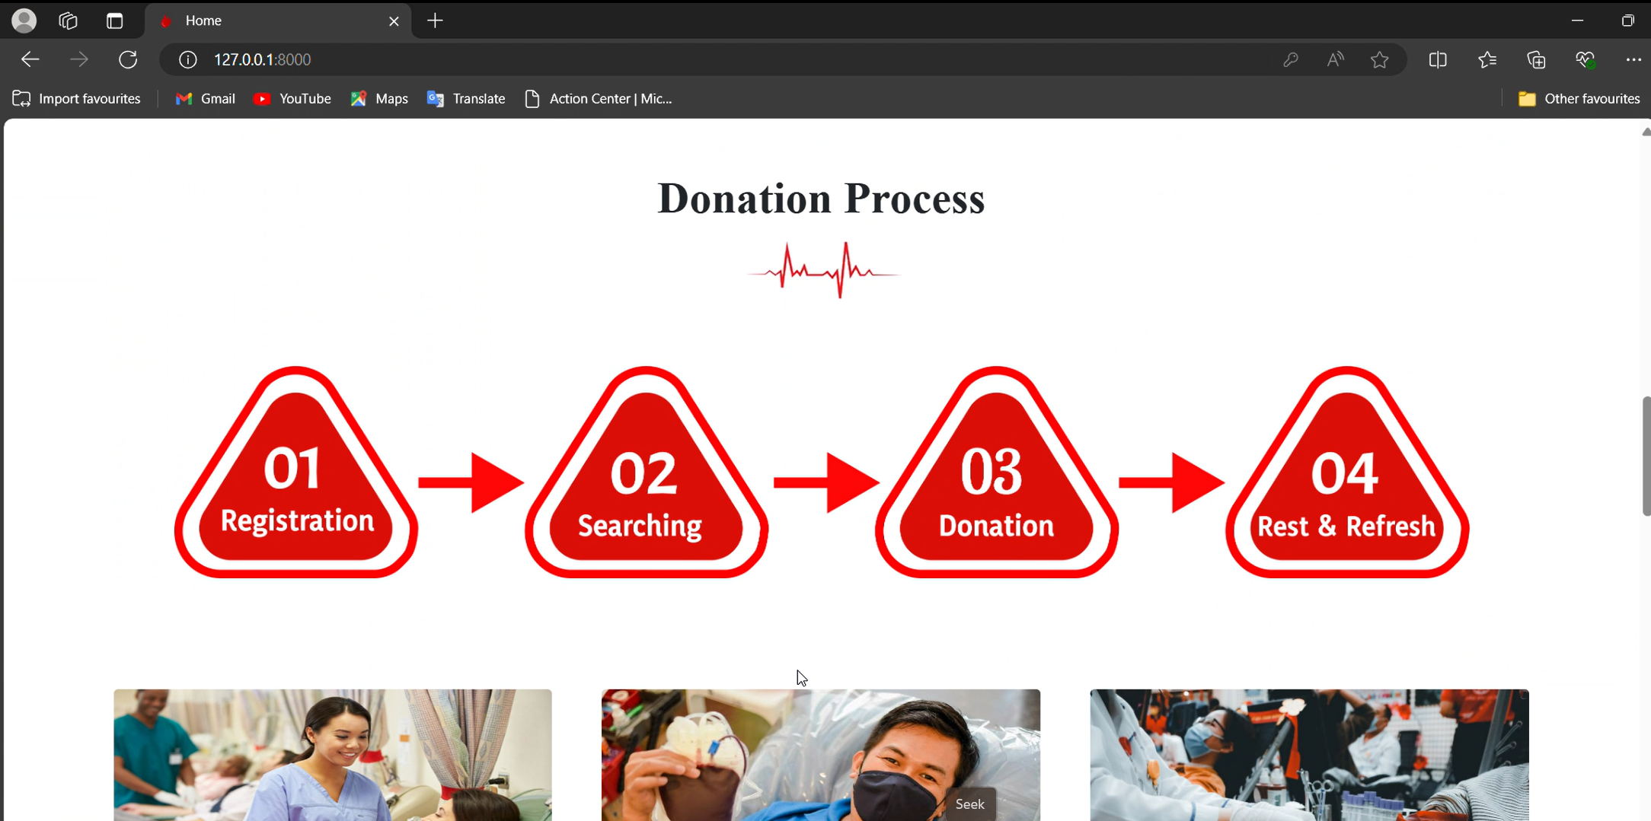

Slide 10
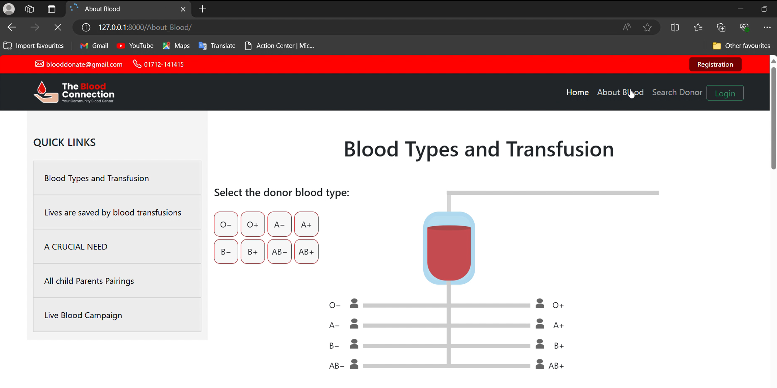

Slide 11
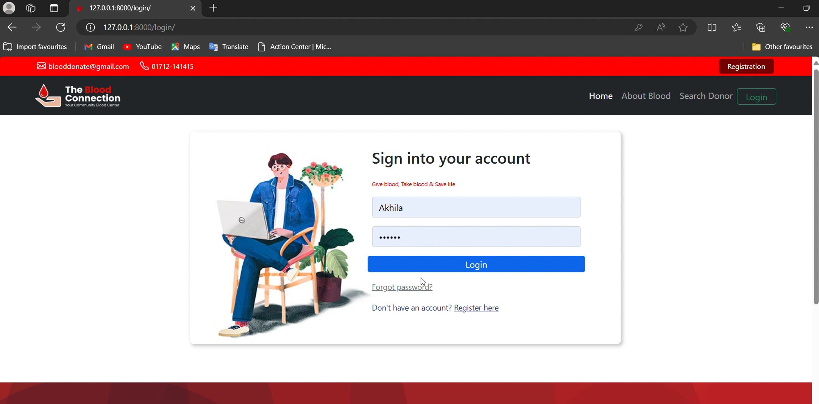

Slide 12
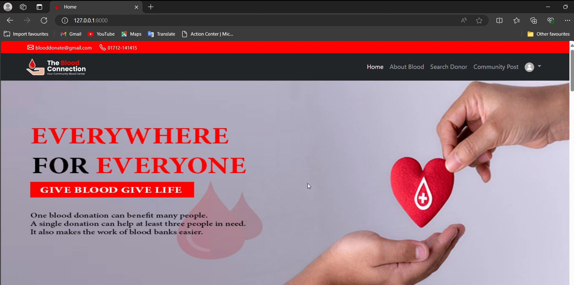

Slide 13
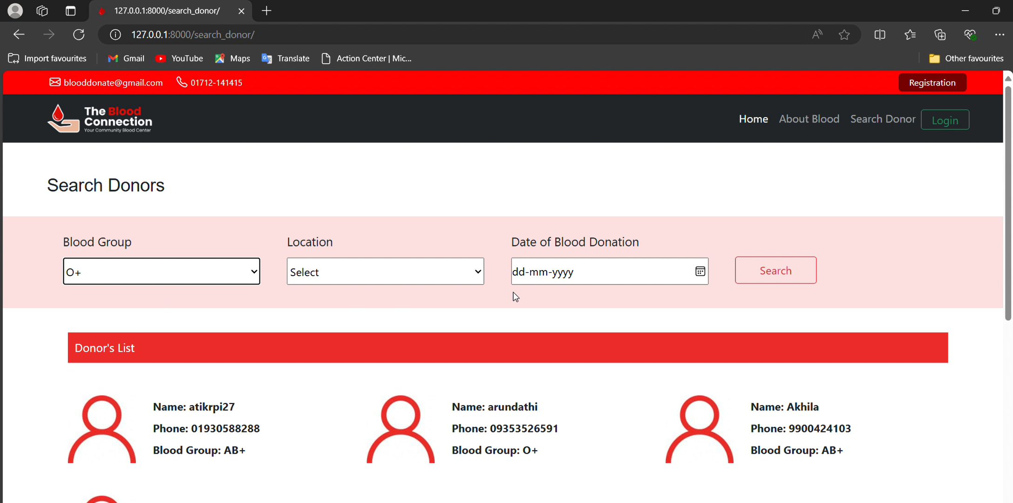

Slide 14
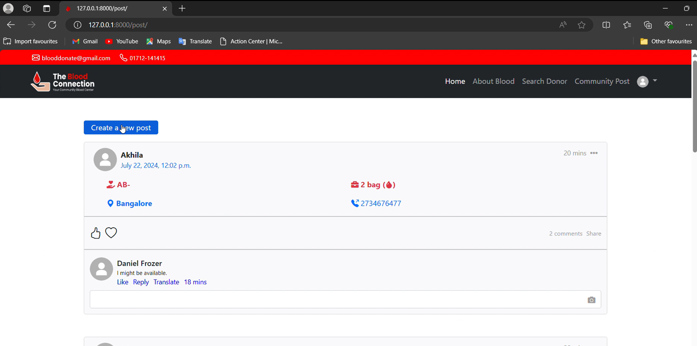

Slide 15
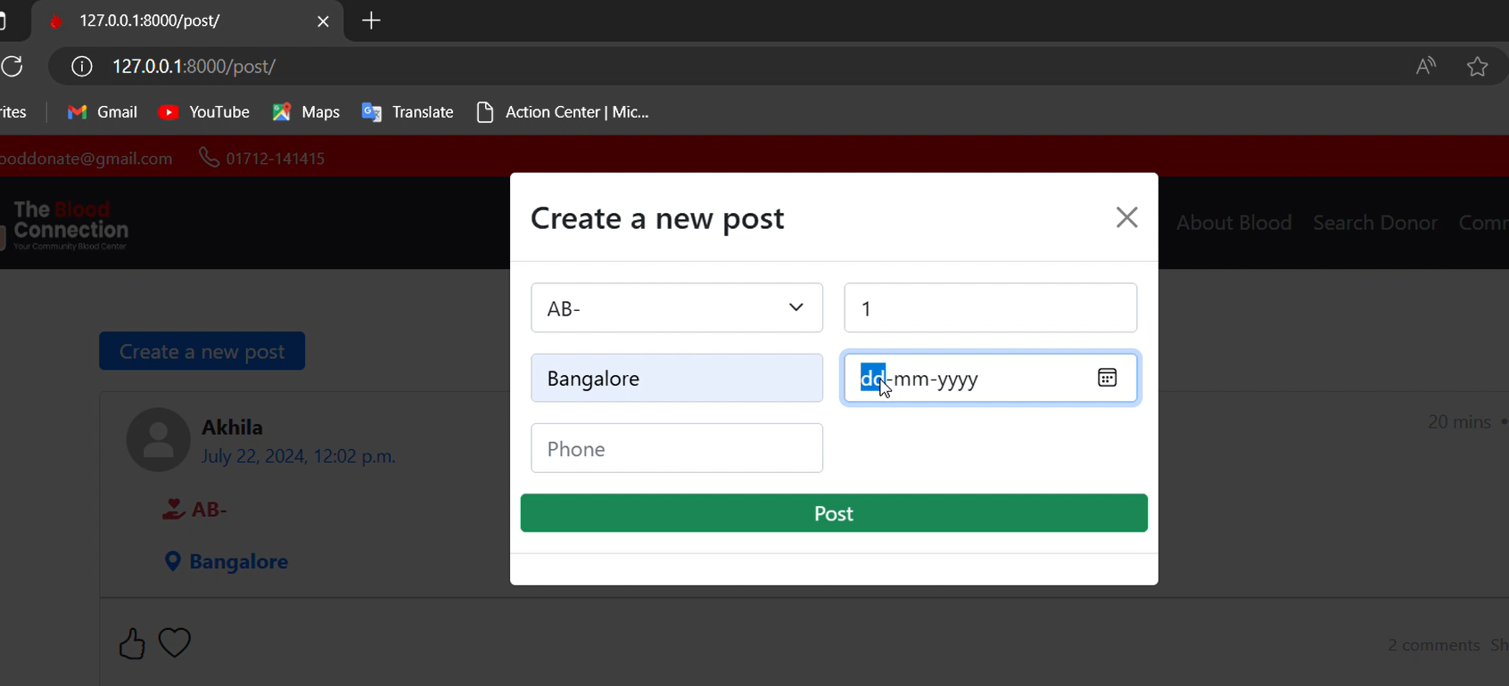

Slide 16
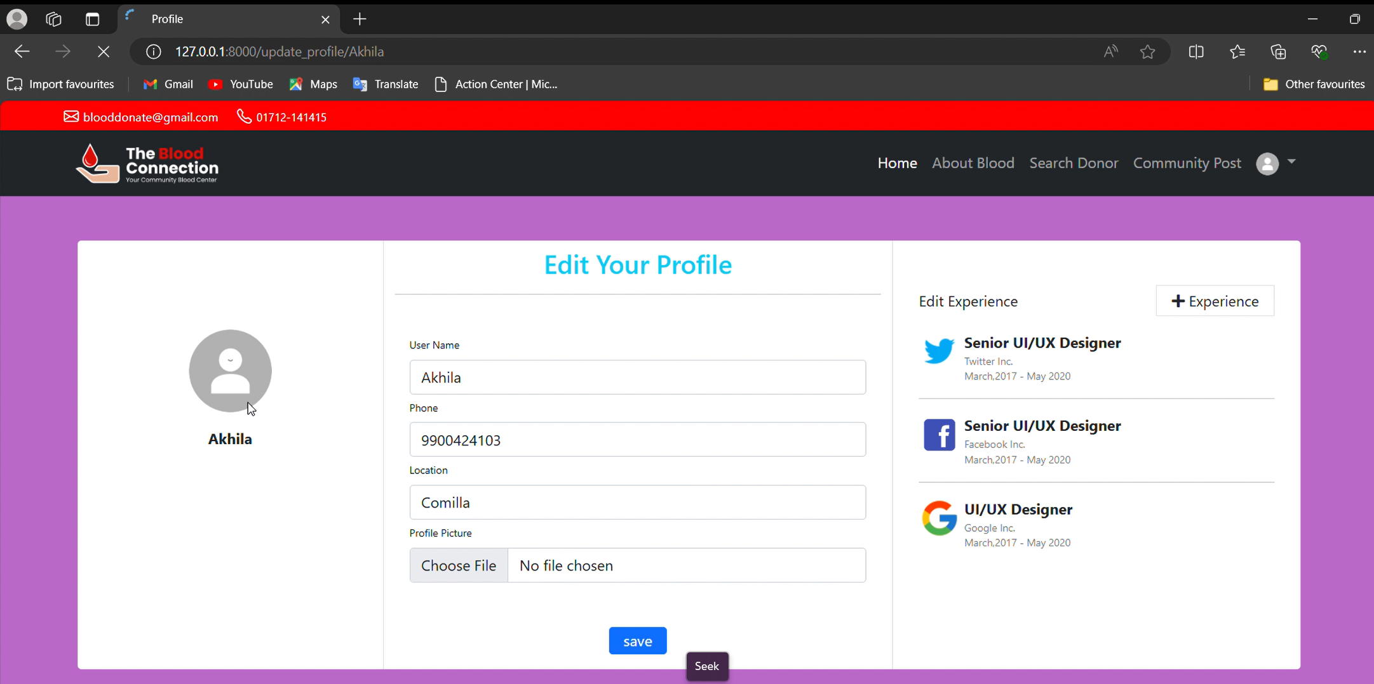

Slide 17
GITHUB: FILE UPLOAD PROCEDURES AND ISSUE RESOLUTION
The development team successfully created a fully functional website, while the documentation team meticulously recorded the entire process. Each team member worked on their respective tasks in separate branches on GitHub, and the final integration was carried out by the project manager through branch merging. Once the files were downloaded and tested by various team members, several issues arose that needed attention. These ranged from code conflicts to functionality bugs. The development team promptly addressed these concerns, implementing fixes to ensure seamless performance across the project.

Slide 18
THANK YOU !

